Slide 1



Future in Motion: Strengthening Road Transport Research
STREnGth_M webinar series: Webinar #1
3 September 2025, 15:30 – 17:00 (CET)
Registration link: STREnGth_M Webinar #1: Future in Motion | POLIS
This project has received funding from the European Union’s Horizon Europe research and innovation programme under grant agreement No 101096253. This document reflects only the author’s view. The Commission and CINEA Agency are not responsible for any use that may be made of the information it contains.

Slide 2



ATTENTION!
This webinar will be recorded

Slide 3
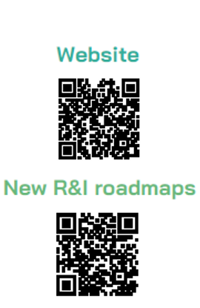
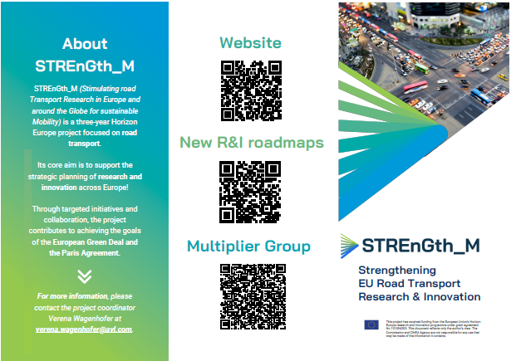


Slide 4
AGENDA
Moderator: Karen Vancluysen, POLIS
15:30 - 15:40 Introduction to the STREnGth_M project with Verena Wagenhofer, AVL/AT
15:40 - 15:50 Introduction to the STREnGtH_M Multiplier Group with Andrew Winder, ERTICO
15:50 - 16:00 Introduction to the ERTRAC Working Groups with Xavier Aertsens, ERTRAC
16:00 - 16:15 ERTRAC Road Transport Vision 2050 with Peter Urban, IKA, Aachen University
16:15 - 16:30 Presentation of new roadmap: Integrated Urban Mobility Roadmap (2024) with Ivo Cré, POLIS
16:30 - 16:45 Presentation of new roadmap: Long Distance Freight Transport, A roadmap for competitive, sustainable and resilient Road Transport (publication pending ~ end of 2025) with Franziska Schmidt, UGE
16:45 - 17:00 Joint Discussion + Q&A
17:00 The End

Slide 5
Joint discussion + QA!

Slide 6

Key links and documents
STREnGth_M “Stimulating road Transport Research in Europe and around the Globe for sustainable Mobility”: https://www.ertrac.org/support-actions/strength_m/
ERTRAC: https://www.ertrac.org/
ERTRAC Newsletter: https://www.ertrac.org/#newsletter
STREnGth_M Multiplier Group: https://www.ertrac.org/news/strength_m-gives-an-insight-into-its-multiplier-group/
ERTRAC Vision 2050: https://www.ertrac.org/wp-content/uploads/2024/06/ERTRAC-Vision-2050-adopted-ERTRAC-Plenary-24-06-2024.pdf
Integrated Urban Mobility Roadmap: https://www.ertrac.org/wp-content/uploads/2024/09/2024-ERTRAC_ALICE_ERRAC_UM_Roadmap.pdf
Long Distance Freight Transport, A roadmap for competitive, sustainable and resilient Road Transport: Publication pending ~end of 2025 – https://www.ertrac.org/documents/
Circular Economy and Competitiveness of European Road Transport: Strengthening sustainability and resource sovereignty of the automotive industry: https://www.ertrac.org/wp-content/uploads/2025/07/ERTRAC_CircularityCompetitiveness_Roadmap_2025_Final.pdf

Slide 7
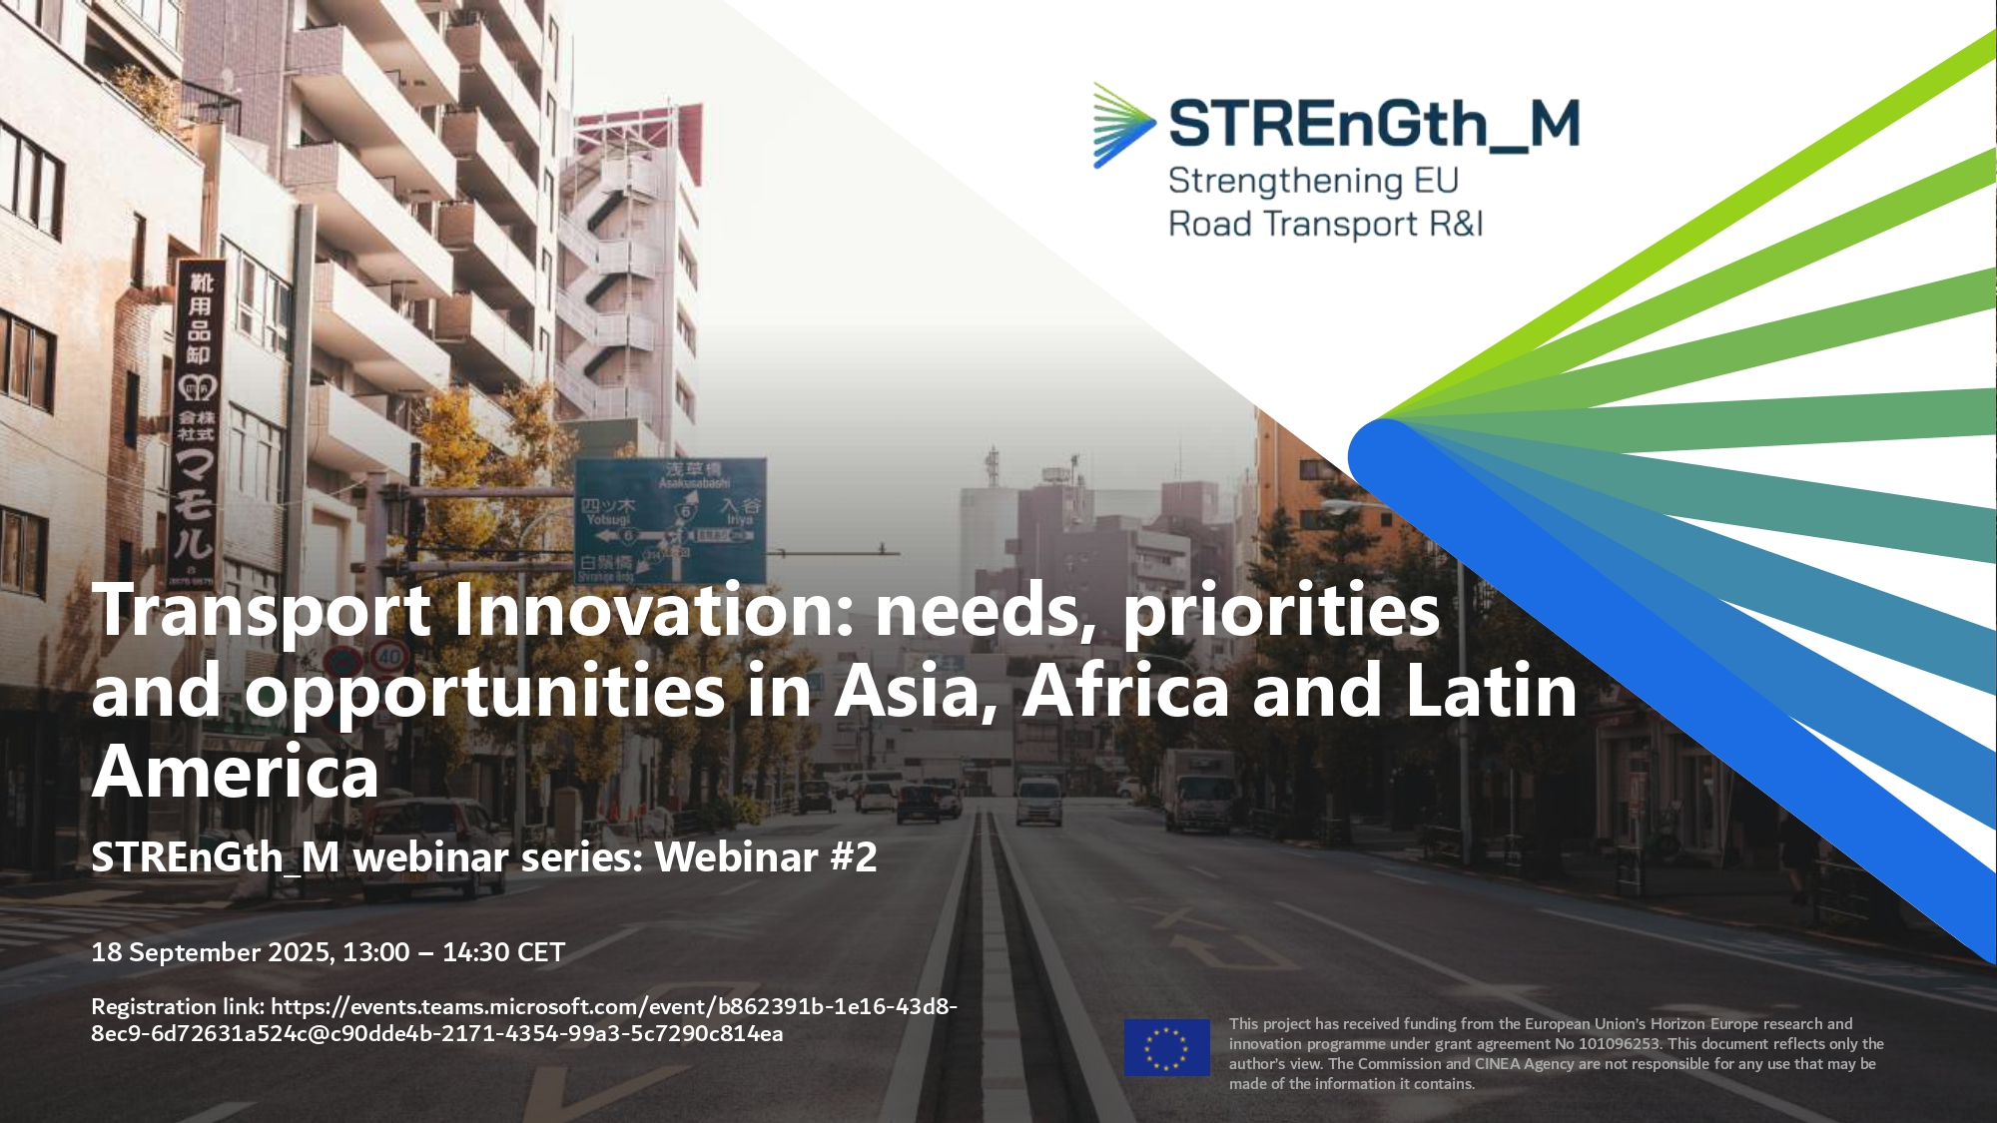
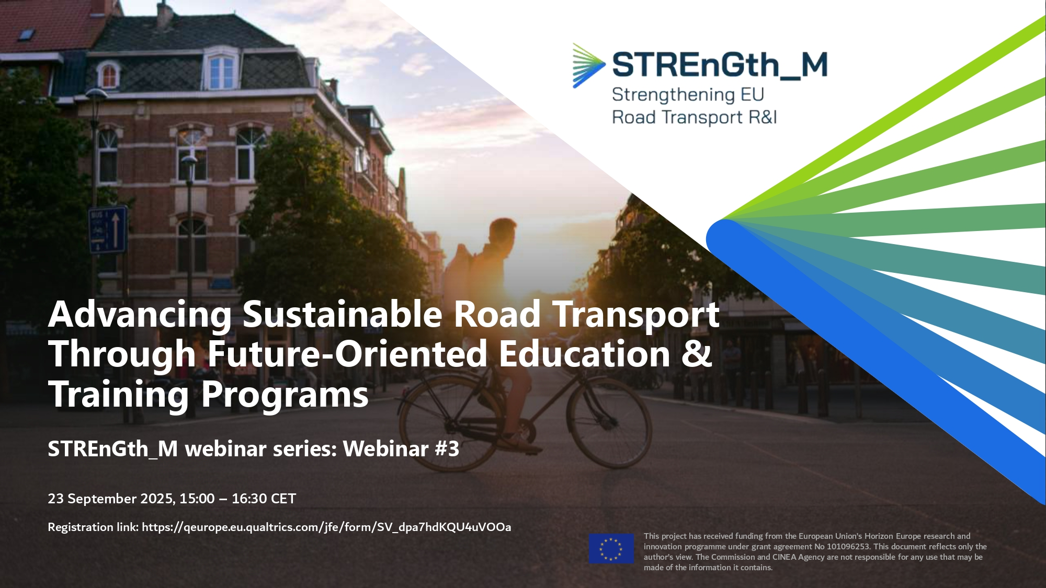
Our upcoming webinars
Webinar #2 - “Transport Innovation: Needs, Priorities and Opportunities in Asia, Africa and Latin America”
  18 September, 13:00 - 14:30 h
  Co-hosted by UN-Habitat and UEMI
  Focus: explore transport innovation needs, regional priorities, and emerging opportunities across these three regions
  https://www.ertrac.org/event/strength_m-webinar-2-transport-innovation/
Webinar #3 - "Advancing Sustainable Road Transport Through Future-Oriented Education & Training Programs“
  23 September, 15:00 - 16:30 h
  Hosted by Rupprecht Consult
  Focus: connecting STREnGth_M with the academic and research community, sharing key findings and innovations with students, professors, and researchers
  https://www.ertrac.org/event/strength_m-webinar-3-future-in-motion/

Slide 8

Thank you!

