Slide 1
ERTRAC
Overview of Working Groups
STREnGth_M webinar
03 September 2025

Slide 2
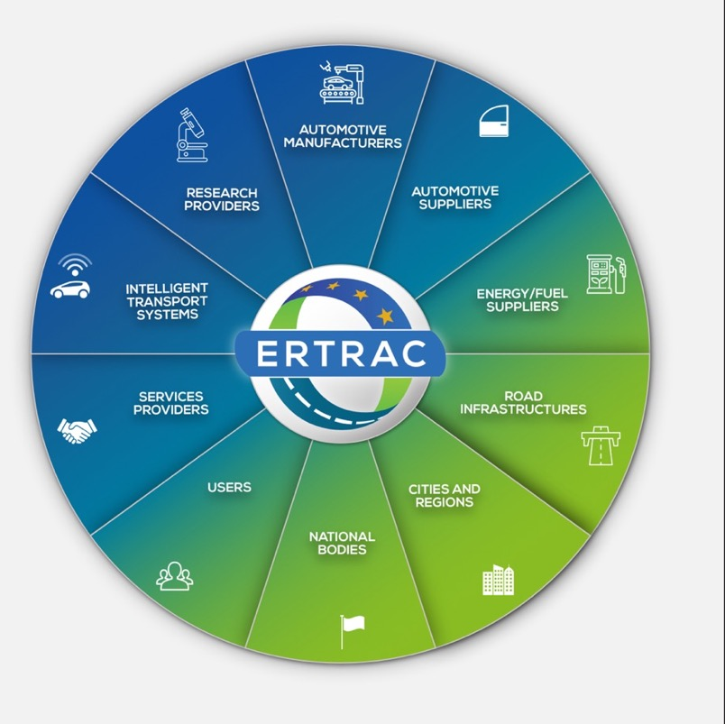
ERTRAC is the European Technology Platform (ETP) for Road Transport recognised and supported by the European Commission.
Members gather all the stakeholders of Road Transport Research: involving industry and researchers, private and public organisations, including authorities from national and local levels.

Slide 3
ERTRAC organisation overview
Plenary
Gathering all the ERTRAC members;
Establishing the strategic orientations of the technology platform;
Endorsing the publications.
Working Groups
Gathering experts from the ERTRAC members;
Responsible for the preparation of the ERTRAC documents;
Co-managed by industry and research Leaders.

Slide 4
ERTRAC Working Groups
Urban Mobility
Energy & Environment
Safety & Security
Long Distance Freight Transport
Circularity &
Competi-tiveness
Connectivity & Automated Driving

Slide 5
New ERTRAC Task Force on Digitalisation
Should become a permanent ERTRAC Working Group
Rationale & need: a strategic initiative to address the critical role of digital technologies in future road transport
Short-term task: should contribute to the drafting of the Automotive Partnership
two horizontals “SDV, E/E, Software Architecture, Building Blocks and Interfaces” &
“AI Vehicles Functions and Services + Data + Cybersecurity”
Invitation to ERTRAC Members to nominate experts
2 Co-Leaders from industry and academia to be nominated by the members

Slide 6
WG Digitalisation in Road Transport
Cross-domain
Cyber sec. & robust
Stability
AI
Real time decision making
Com. Tech.
V2X
Data
Quality, value
Vehicle design
Integration in UM system
(Charging) Strategies and tools
Real-time data exchange
Enhance safety, TM
Training, V&V
System reliability
Secure vehicle control, data privacy, safety
System integrity
Data bias
Tools for data annotation
Planning of operation

Slide 7
Contact:
Xavier Aertsens
ERTRAC Office Director
Avenue de Cortenbergh 66
1000 Brussels
xavier.aertsens@ertrac.org
http://www.ertrac.org
ERTRAC is registered in the EU Transparency Register under the ID number: 855647016671-07

